Slide 1
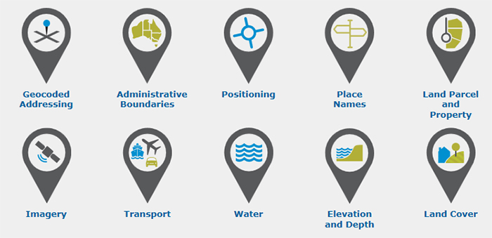
Australia's distributed national spatial dataset production systems and community
Nicholas Car Data Architect nicholas.car@ga.gov.au

Slide 2
Outline
The Foundational Spatial Data Framework
What it is - in outline
What it is not
W3C standards & models
Linked Data use
Spatial reference data
Social architecture

Slide 3
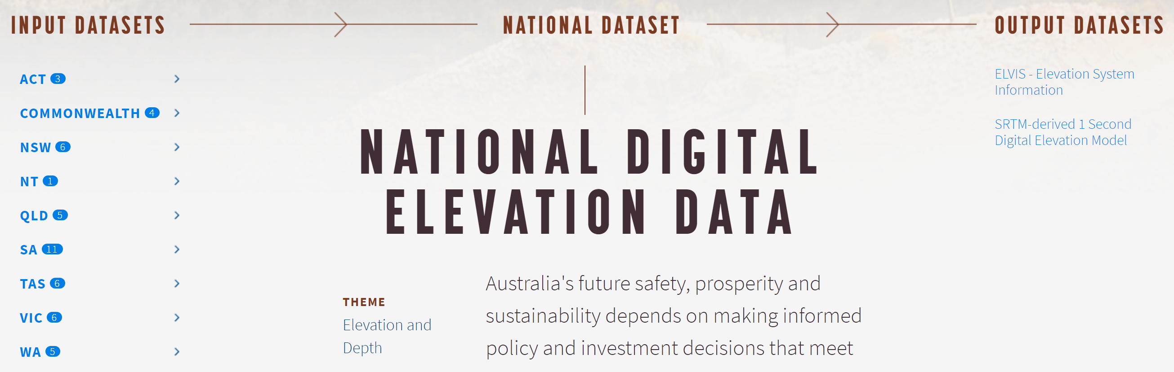
The Foundational Spatial Data Framework
FSDF: a Federal and State government initiative to streamline the production of national spatial data products
for the Dept. Prime Minster & Cabinet
coordinated by Geoscience Australia

Slide 4
The Foundational Spatial Data Framework
FSDF: a Federal and State government initiative to streamline the production of national spatial data products
for the Dept. Prime Minster & Cabinet
coordinated by Geoscience Australia
Are there legal mandates and funding sources for these?

Slide 5
The Foundational Spatial Data Framework
FSDF: a Federal and State government initiative to streamline the production of national spatial data products
for the Dept. Prime Minster & Cabinet
coordinated by Geoscience Australia
Are these accessible generally?

Slide 6
The Foundational Spatial Data Framework
FSDF: a Federal and State government initiative to streamline the production of national spatial data products
for the Dept. Prime Minster & Cabinet
coordinated by Geoscience Australia
Can we process improve the production of these?

Slide 7
The Foundational Spatial Data Framework
FSDF: a Federal and State government initiative to streamline the production of national spatial data products
for the Dept. Prime Minster & Cabinet
coordinated by Geoscience Australia
Can we trace the provenance of these?

Slide 8
The Foundational Spatial Data Framework
What the FSDF is not:
An “awesome tool”
Not “smart”, “machine learning” etc.
A fast, non-permanent ‘initiative’
Started in 2012
Run by one agency
Going to achieve success through one channel

Slide 9
Use of W3C standards & models
Provenance:
Granularity 1: National Dataset level
Dataset level
Input Dataset 1
wasDerivedFrom
Output Dataset A
Input Dataset 2
National Dataset X
Output Dataset B
Input Dataset 3

Slide 10

Use of W3C standards & models
Provenance:
Granularity 2: Output Dataset Components
Feature / Component level
Input Dataset 1
wasDerivedFrom
Output Dataset A
Input Dataset 2
Input Dataset 3

Slide 11
Use of W3C standards & models
Provenance:
Granularity 3: National Dataset fabric
Feature / Component level with reference datasets
Input Dataset 1
Input Dataset 1
Input Dataset 3
wasDerivedFrom
Output Dataset A
Input Dataset 2
The National Dataset
Input Dataset 2
Input Dataset 6
Output Dataset B
Input Dataset 3
Input Dataset 3
Input Dataset 9

Slide 12
Use of W3C standards & models
Granularity 1: National Dataset level, work to date
FSDF Ontology
DCAT
PROV
ORG

Slide 13
Use of W3C standards & models
Granularity 2: Output Dataset components, next FY + 3
FSDF Ontology
DCAT
QB4ST
PROV
ORG

Slide 14
Use of W3C standards & models
Granularity 3: National Dataset fabric, start 3+ years away
FSDF Ontology
DCAT
QB4ST
PROV
TIME
ORG
Lots of Vocs
SSN

Slide 15
Linked Data use
Currently, datasets, if available online, are in GeoNetwork or CKAN catalogues

Slide 16
Linked Data use
Currently, datasets, if available online, are in GeoNetwork or CKAN catalogues
Realistically, no semantics of value beyond DCAT
Students working on a baseline now

Slide 17
Linked Data use
Currently, datasets, if available online, are in GeoNetwork or CKAN catalogues
Government metrics/requirements bound to ISO19*

Slide 18
Linked Data use
Currently, datasets, if available online, are in GeoNetwork or CKAN catalogues
Government metrics/requirements bound to ISO19*
Linked Data API will be used for increasing semantics while preserving backwards-compatibility

Slide 19
Linked Data use
Linked Data API will be used for increasing semantics while preserving backwards-compatibility
eCat example:
ISO19115 XML
GeoNetwork normal
ISO19115-derived HTML
Dataset

Slide 20
Linked Data use
Linked Data API will be used for increasing semantics while preserving backwards-compatibility
eCat example:
ISO19115 XML
ISO19115-derived HTML
Dataset
Limited DCAT RDF

Slide 21
Linked Data use
Linked Data API will be used for increasing semantics while preserving backwards-compatibility
eCat example:
ISO19115 XML
Schema.org
ISO19115-derived HTML
Dataset
Limited DCAT RDF

Slide 22
Linked Data use
Linked Data API will be used for increasing semantics while preserving backwards-compatibility
eCat example:
ISO19115-1 XML Enhanced!
Schema.org
ISO19115-derived HTML
Dataset
Limited DCAT RDF

Slide 23
Linked Data use
Linked Data API will be used for increasing semantics while preserving backwards-compatibility
eCat example:
FSDF Ont
ISO19115-1 XML Enhanced!
Schema.org
ISO19115-derived HTML
Dataset
Limited DCAT RDF

Slide 24
Linked Data use
Linked Data API will be used for increasing semantics while preserving backwards-compatibility
eCat example:
FSDF Ont
?
ISO19115-1 XML Enhanced!
Schema.org
ISO19115-derived HTML
Dataset
Limited DCAT RDF

Slide 25
Spatial Reference Data
We need reference semantic data, not just models
Common Subjects P O to associate facts with
The Geofabric was the first attempt
Known relationships in separate
graphs not enough

Slide 26
Spatial Reference Data
We need reference semantic data, not just models
Common Subjects P O to associate facts with
The Geofabric was the first attempt
Need common nodes

Slide 27
Spatial Reference Data
We need reference semantic data, not just models
Common Subjects P O to associate facts with
The Geofabric was the first attempt
Mothballed due to lack of sophisticated users

Slide 28
Spatial Reference Data
We need reference semantic data, not just models
Common Subjects P O to associate facts with
The Geofabric was the first attempt
Let’s aim simpler:
Admin boundaries
Far fewer difficult spatial elements
Far more popular

Slide 29
Spatial Reference Data
We need reference semantic data, not just models
Common Subjects P O to associate facts with
The Geofabric was the first attempt
Let’s aim simpler:
Admin boundaries
Organisations
Non-spatial but most common dataset
Works in Sem Web + Legacy systems

Slide 30
Social Architecture is paramount
We need coordination
As the FSDF is providing – spatial

Slide 31
Social Architecture is paramount
We need coordination
As the FSDF is providing – spatial
More general LD support needed
New/hard for agencies
AGLDWG

Slide 32



Australian Government Linked Data Working Group
http://linked.data.gov.au | agldwg-all@lists.csiro.au
About
Government Linked Data experts and champions. It draft policy and technical guidance on the implementation of Linked Data for the Australian Government. Open to all Federal entities and friends.
Solutions
Recomm-endations
Subgroups
What is Linked Data?
Visibility

Slide 33
Australian Government Linked Data Working Group
http://linked.data.gov.au | agldwg-all@lists.csiro.au
About
Government Linked Data experts and champions. It draft policy and technical guidance on the implementation of Linked Data for the Australian Government. Open to all Federal entities and friends.
Solutions
Members
Australian Bureau of Statistics
Australian National University (Chair)
Bureau of Meteorology
CSIRO
Dept. of Communications
Dept. of Finance
Dept. of Human Services
Dept. of the Prime Minister and Cabinet
Geoscience Australia
National Archives of Australia
Informal Members
National Computational Infrastructure
Link Digital
Intersect Australia
PSMA
Recomm-endations
Subgroups
What is Linked Data?
Visibility

Slide 34
Australian Government Linked Data Working Group
http://linked.data.gov.au | agldwg-all@lists.csiro.au
About
Government Linked Data experts and champions. It draft policy and technical guidance on the implementation of Linked Data for the Australian Government. Open to all Federal entities and friends.
Solutions
All of Govt. LD tooling
Members
Australian Bureau of Statistics
Australian National University (Chair)
Bureau of Meteorology
CSIRO
Dept. of Communications
Dept. of Finance
Dept. of Human Services
Dept. of the Prime Minister and Cabinet
Geoscience Australia
National Archives of Australia
Informal Members
National Computational Infrastructure
Link Digital
Intersect Australia
PSMA
Recomm-endations
Subgroups
(those that do things)
How to make Linked Data
What is Linked Data?
Visibility
Organising the Aust. LD community

Slide 35
Australian Government Linked Data Working Group
http://linked.data.gov.au | agldwg-all@lists.csiro.au
About
Government Linked Data experts and champions. It draft policy and technical guidance on the implementation of Linked Data for the Australian Government. Open to all Federal entities and friends.
Link with us!
Solutions
All of Govt. LD tooling
Members
Australian Bureau of Statistics
Australian National University (Chair)
Bureau of Meteorology
CSIRO
Dept. of Communications
Dept. of Finance
Dept. of Human Services
Dept. of the Prime Minister and Cabinet
Geoscience Australia
National Archives of Australia
Informal Members
National Computational Infrastructure
Link Digital
Intersect Australia
PSMA
Recomm-endations
Subgroups
(those that do things)
How to make Linked Data
What is Linked Data?
Visibility
Organising the Aust. LD community

Slide 36
Social Architecture is paramount
We need coordination
As the FSDF is providing – spatial
More general LD support needed – LD
Funding and policy drivers

Slide 37
Social Architecture is paramount
We need coordination
As the FSDF is providing – spatial
More general LD support needed – LD
Funding and policy drivers
A role for the proposed National Data Custodian?

Slide 38
Social Architecture is paramount
We need coordination
As the FSDF is providing – spatial
More general LD support needed – LD
Funding and policy drivers
Communities of Practice to evolve legacy systems
GeoNetworks
CKAN
Vocabularies
“Old” spatial standards

Slide 39
Social Architecture is paramount
We need coordination
As the FSDF is providing – spatial
More general LD support needed – LD
Funding and policy drivers
Communities of Practice to evolve legacy systems
Flagship products
Overcome the Geofabric hump!
Broad: the whole FSDF
Deep: a specific FSDF product

Slide 40
Nicholas Car
Data Architect
nicholas.car@ga.gov.au
FSDF
http://fsdf.org/LINK
Geoscience Australia
http://www.ga.gov.au
Aust. Gov. Linked Data WG
http://linked.data.gov.au

